Slide 1
Field Occupation
Spacing / Gapping

Slide 2
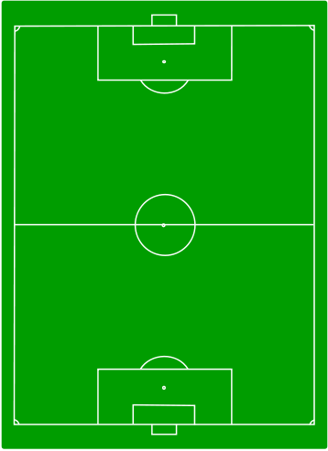
K
# 1
The space between the back 3 and the rest of the team is too much -- This disconnects the team. The back 3 need to move forward and close the space
K

Slide 3
# 2
The gap now is between the lone forward and the rest of the team. The forward needs to come back into the space to connect with the rest of the team.
Also, the 2 red defenders need to move forward and support the attack.

Slide 4
# 3
The ideal positioning with NO gaps. The entire team is compact and can win the ball back when possession is lost.

Slide 5
# 4
The blue team has proper defensive positions.
The red team has gapping issues now as the backs must connect with the rest of them.

Slide 6
# 5
Proper positioning for both teams as the play is centered in the middle of the field.

